Slide 1

Deep Learning
Abhishek Sharma

Slide 2
- Deep learning is a subset of machine learning that teaches computers to do what comes naturally to humans: learn by example.
- Deep learning is a key technology behind driverless cars, voice control in consumer devices and many more technological advancements.
- Deep learning models can achieve state-of-the-art accuracy, sometimes exceeding human-level performance.

Slide 3
Why Deep Learning Matters ?
- In a word, accuracy. Deep learning achieves recognition accuracy at higher levels than ever before. This helps consumer electronics meet user expectations, and it is crucial for safety-critical applications like driverless cars. Recent advances in deep learning have improved to the point where deep learning outperforms humans in some tasks like classifying objects in images.
- Humongous amounts of data and tremendous computational prowess has made Deep Learning talk of the tongue in the current era.

Slide 4
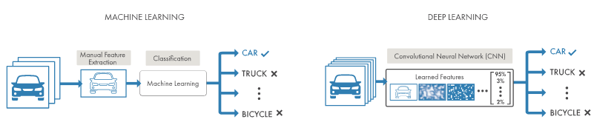
Machine Learning Vs Deep Learning

Slide 5
Machine Learning Vs Deep Learning
- No need for manual extraction of features anymore, Deep Learning would automate that part for you.
- Deep Learning models would continue to improve as the size of your data increases.
- More data means improved reliability.
- And of course, better ACCURACY.

Slide 6
Table of contents
Neural Networks
01
Forward and Backward Propagations
02
Optimizing functions
03
Activation Functions
Initializers
CNN

Slide 7
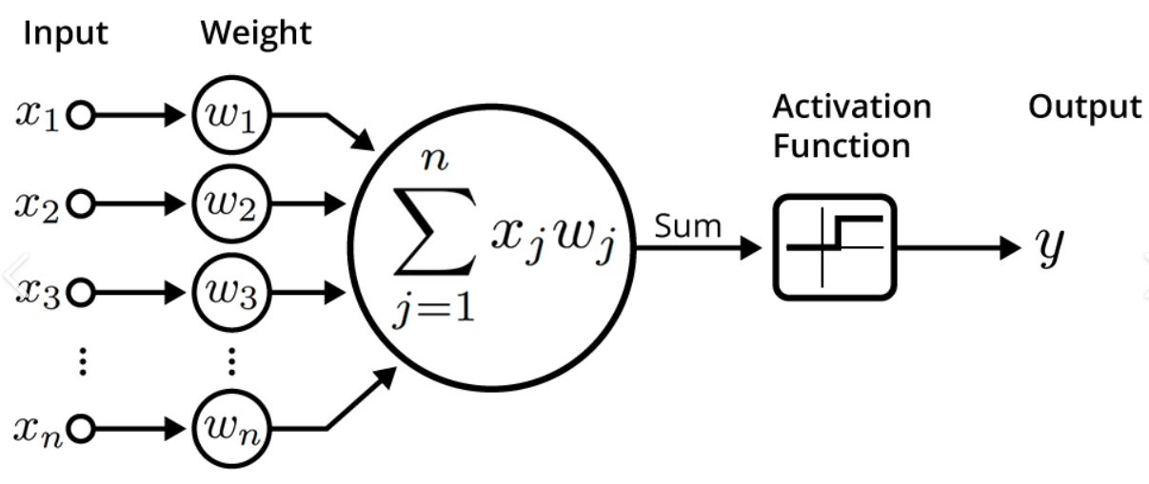
Perceptron

Slide 8
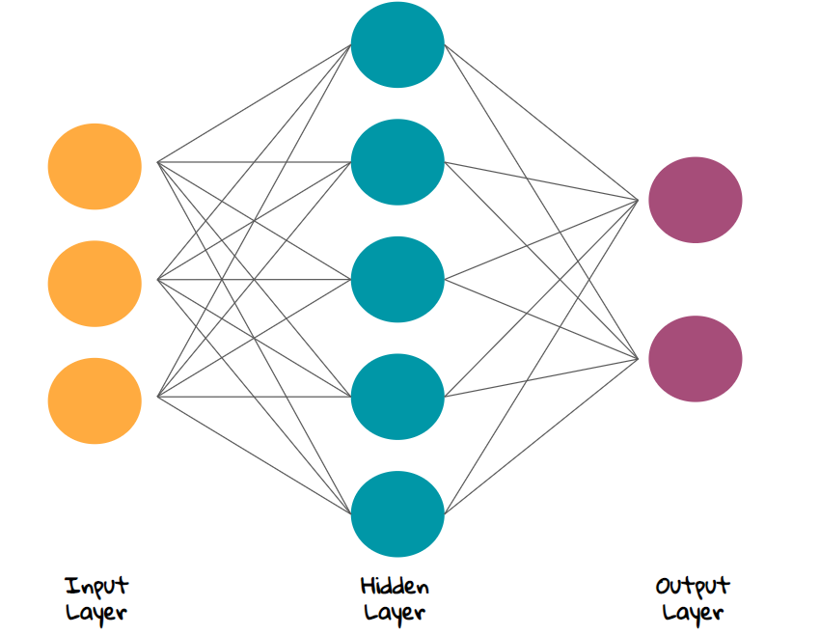
Neural Network

Slide 9
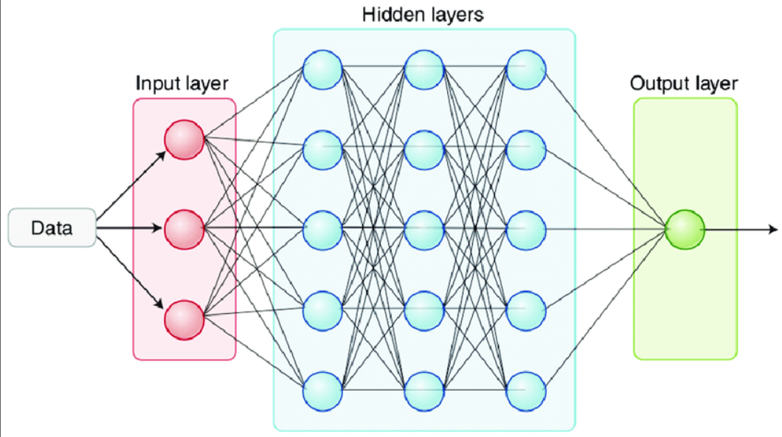
Deep Neural Network

Slide 10
Neural Networks
- Backbone of Deep Learning.
- Consisting of layers : Input layer(one), hidden layer(-multiple), output layer(one).
- Each layer is a cluster of neurons.
- Each neuron in a layer is connected to all the neurons of the previous layer and all the neurons of the next layer.
- Each neuron is a combination of functions : Weighted sum, Activation Function.
- The output of the current layer is the input to the next layer.

Slide 11
Neurons
- Unit of a layer in a network.
- Combination of functions – Sum function, activation.
- Sum function: Weighted sum = wTx + b.
- Activation function: sigmoid(logistic), tanh(hyperbolic tangent), ReLU, Leaky ReLU, ELU, PReLU, Swish, Softplus, Softmax.
- Takes in inputs, processes through {performs sum function followed by the Activation function}, renders the outputs.

Slide 12
Input Layer
- Corresponds to the Feature Layer of the Network.
- Has n number of neurons; n=no of features in the dataset.
- Very first layer of the Network.

Slide 13
Hidden Layer
- Is one of the most important layers of the Network.
- Responsible for the calculation and identification of the relationship between the feature and the target variables.
- There can be multiple hidden layers in a network.
- ANN with many hidden layers is called Deep NN.

Slide 14
Output Layer
- The last layer; renders the final output.
- Loss function is calculated after this layer.
- Responsible for the overall model output.
- Usually has as many neurons as the number of outputs associated with the input.

Slide 15
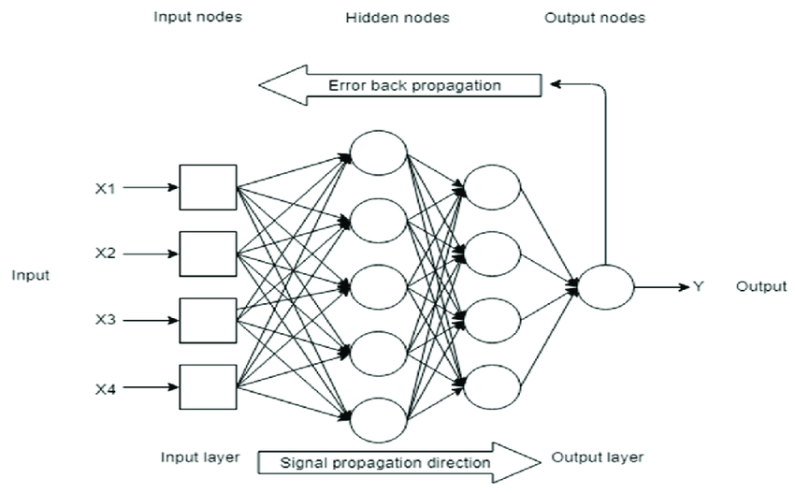
Forward and backward propagation

Slide 16
Forward Propagation
- Inputs are given to each neuron.
- Outputs are calculated for each layer, which are passed to the next layers as inputs till the end.
- This is done for all the records.
- Error function is calculated.

Slide 17
Backward propagation
- Based on the error calculated, the gradients are calculated.
- Using these gradients, the new weights are calculated.
- The weights updation is done from back to front i.e output layer > hidden layer > input layer.

Slide 18
Epoch
Forward Propagation
Error calculation
Back propagation AND Parameters updatION
GRADIENTS CALCULATION

Slide 19
Section I
Optimizers

Slide 20
Optimizers
- Responsible for figuring the optimum values of updatable parameters.
- Minimizes the error.
- Helps in achieving convergence efficiently.
- Most commonly known optimizer: Gradient Descent.

Slide 21
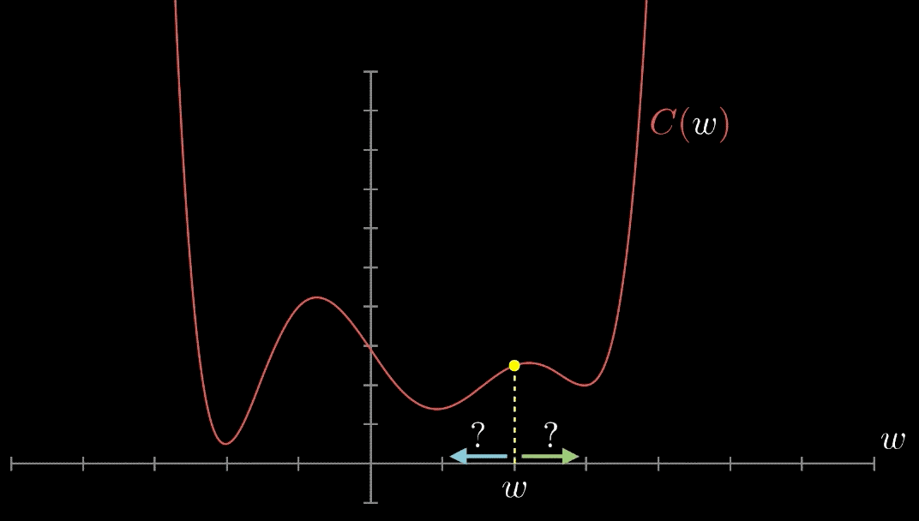
Optimizers

Slide 22
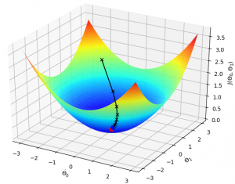
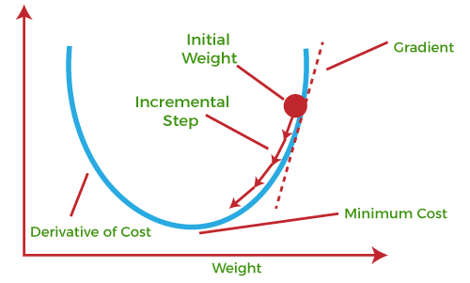
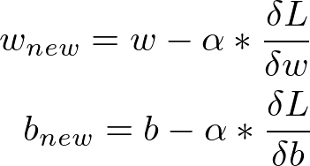
Gradient Descent(Batch Gradient Descent)

Slide 23
Gradient Descent (Batch Gradient Descent)
- Also called as Batch Gradient Descent.
- Works on the principle of Gradients i.e derivatives, hence the name Gradient Descent.
- Iterates over all the records of the dataset to calculate the loss.
- Fine for smaller datasets but inefficient for the larger datasets.

Slide 24
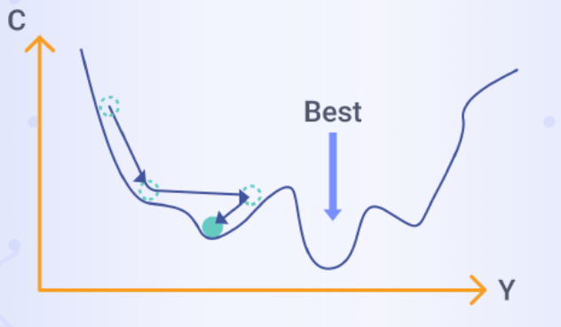
Stochastic Gradient Descent

Slide 25
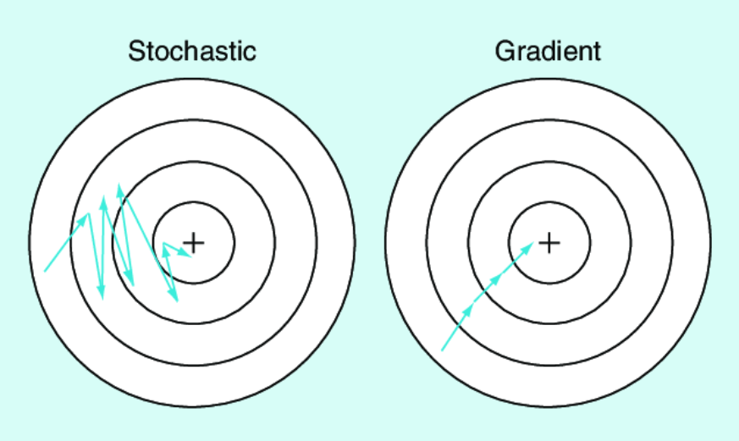
Stochastic Gradient Descent

Slide 26
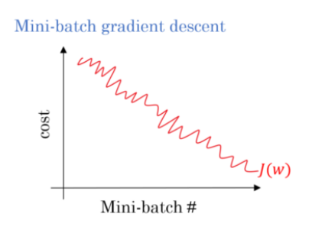
Mini-Batch Stochastic Gradient Descent

Slide 27
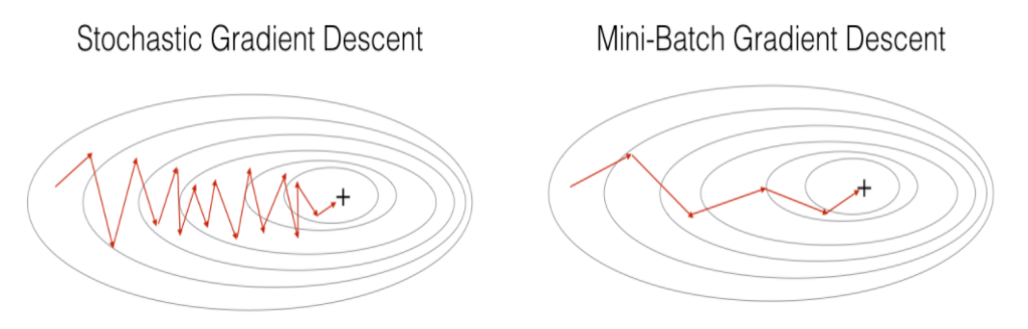
Mini-Batch Stochastic Gradient Descent

Slide 28
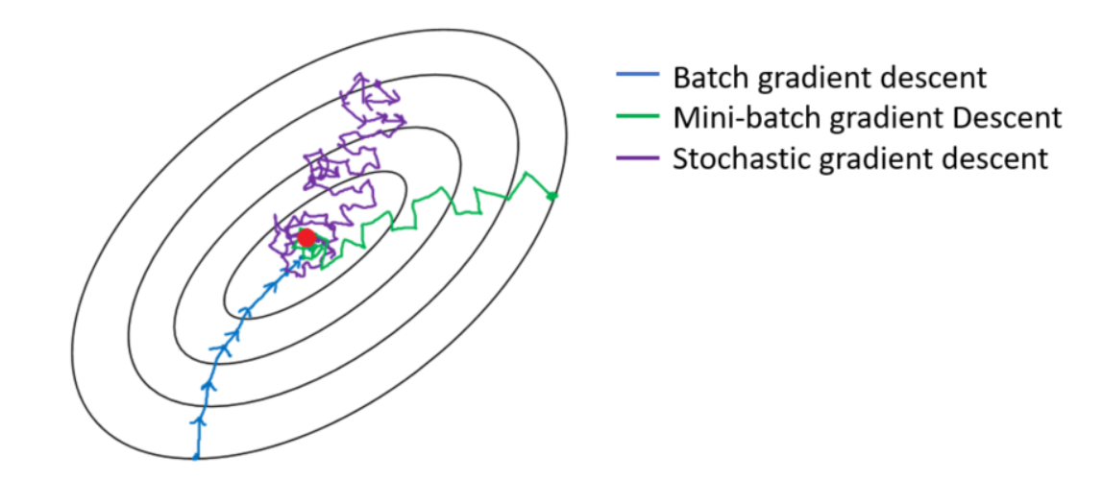
GD vs SGD vs Mini Batch SGD

Slide 29
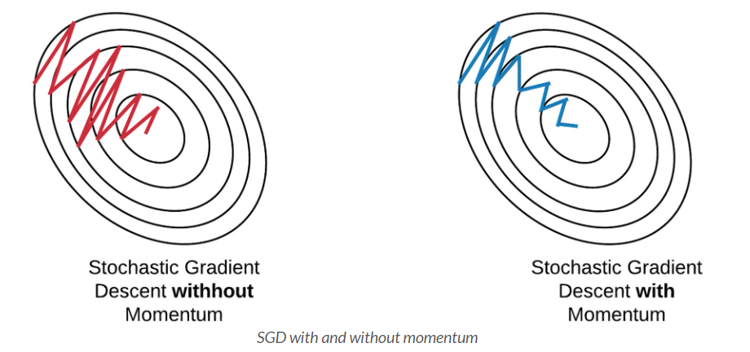
Stochastic Gradient Descent with momentum

Slide 30

Adaptive Gradient Descent(AdaGrad)

Slide 31
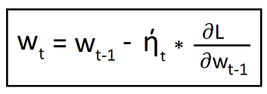

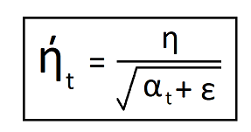
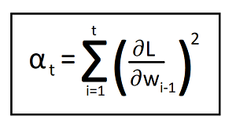
AdaGrad - Mathematical intuition
New weights :
ghts :
where,
and,

Slide 32
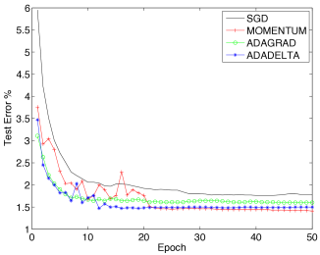
Ada-Delta/ RMS prop

Slide 33
Section II
Activation Functions

Slide 34
Zero centricity
- If the arithmetic mean of the outputs of a function is approximately or near 0 (zero), it is called a zero-centric function.
- A zero centric function would always be better performing in terms of time complexity and computation.

Slide 35
Activation Function
- Inferencing is easy with linear data but when the data becomes complex, the computer finds it difficult to learn the patterns effectively.
- What now ? >>>> Non- linear quadratic functions to treat the outputs from the layers.
- Activation functions are mathematical functions that determines the output of a neuron.
- Attached to each neuron; each layer can have it’s own activation function.
- Determines whether a neuron should be activated or not by bounding its output between limits.

Slide 36
Activation functions
Sigmoid function
Tanh function
RELU
Leaky RELU
ELU
P-relu
Swish relu
Softplus
softmax

Slide 37
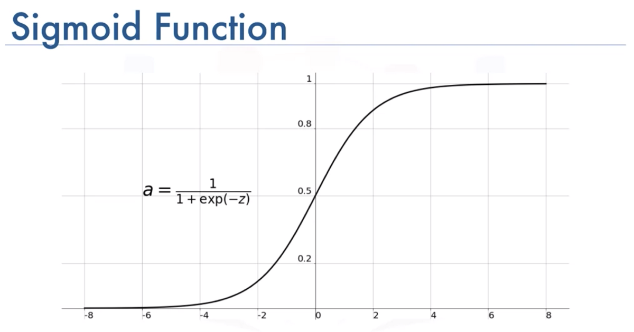

Slide 38
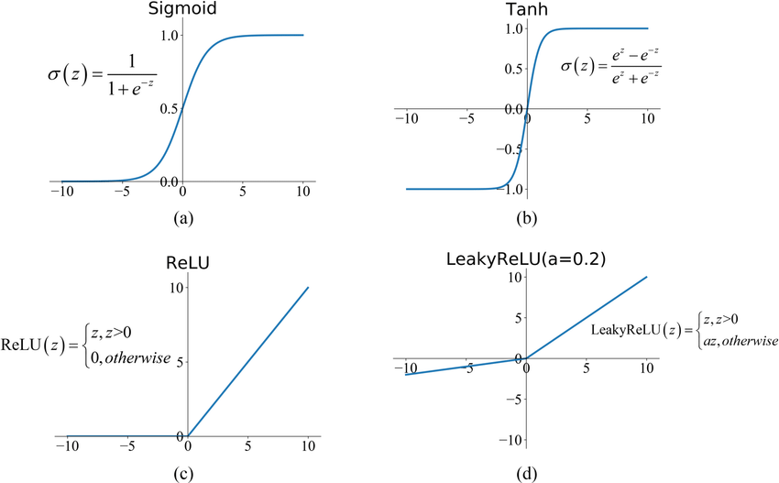
Tanh (hyperbolic tangent) function

Slide 39

RELU – REctified Linear Unit

Slide 40
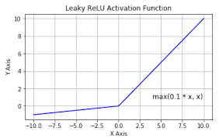
Leaky RELU

Slide 41
Sigmoid vs Tanh vs RELU vs Leaky-RELU

Slide 42
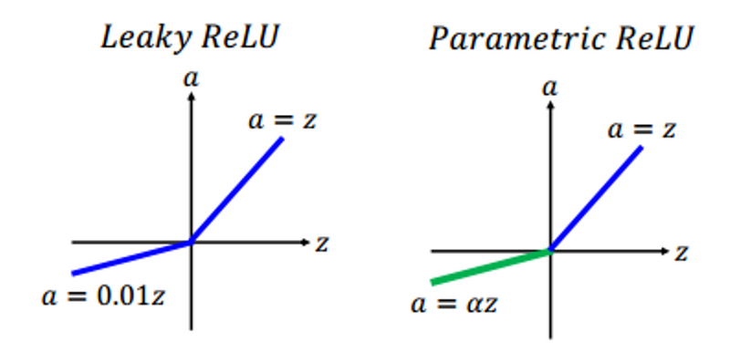
P-RELU (Parametric-RELU)

Slide 43
Leaky RELU vs P-RELU

Slide 44

ELU

Slide 45
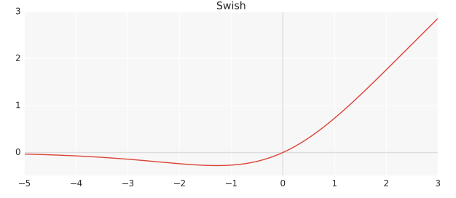
SWISH RELU

Slide 46
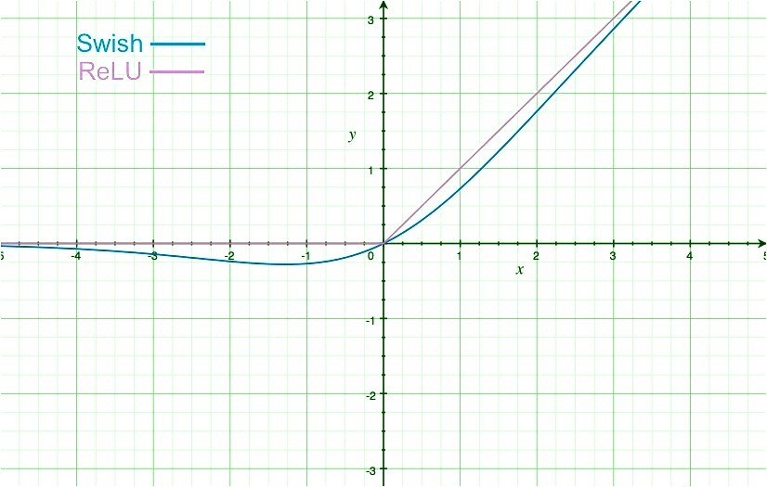
SWISH vs RELU

Slide 47
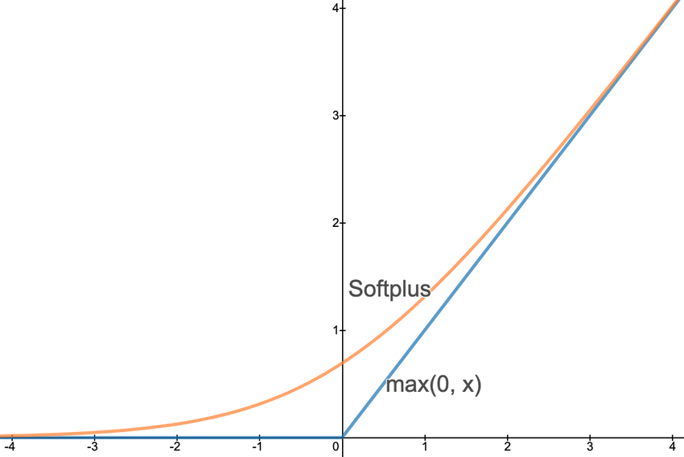
Softplus function

Slide 48
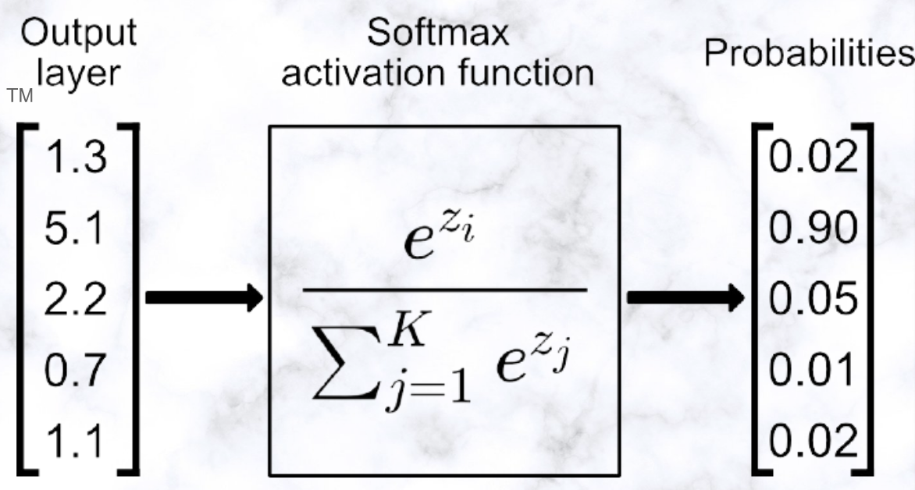
Softmax function

Slide 49
Section III
Loss & Cost Functions

Slide 50
Loss & Cost Function
- In the context of an optimization algorithm, the function used to evaluate a set of parameters is called an objective function.
- The ideal scenario would be to either maximize or to minimize this objective function.
- When we seek to minimize the error i.e measure of divergence of the actual value to the predicted value, this objective function is referred to as the loss function.
- The cost function distills all the important aspects of a complex system into a single numeric value, improvement in which can potentially indicate improvements in the performance of the system itself.

Slide 51
Loss Function
The objective function when applied to a single data point/ record for evaluation of performance is referred to as a Loss Function.

Slide 52
Cost Function
The objective function when applied to an entire dataset representing the overall sample under consideration for evaluation of performance is referred to as a Cost Function.

Slide 53
Cost functions
Mean Squared Error
Mean Squared Logarithmic Error
Mean Absolute Error
Binary Cross-Entropy Loss
Hinge Loss
Squared Hinge Loss
Multi-Class Cross-Entropy Loss
Sparse Multi-Class Cross-Entropy Loss
Kullback Leibler Divergence Loss

Slide 54
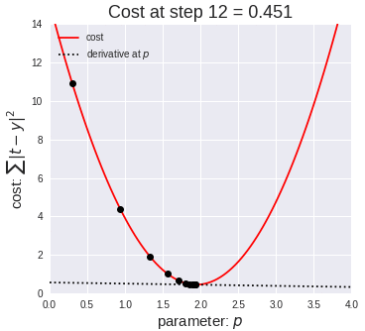
Cost optimization

Slide 55
Regression Losses
- Mean Squared Loss
- Mean Squared Logarithmic Loss
- Mean Absolute Loss

Slide 56
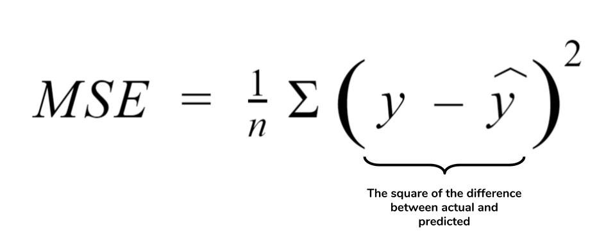
Mean Squared Error

Slide 57
Mean Squared Error
- Default to use in regression problems.
- Result is always positive.
- Squaring penalizes the error more whenever its magnitude is large.
- ‘mse’, ‘mean_squared_error’, keras.loss.mean_squared_error

Slide 58
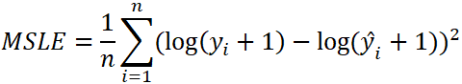
Mean Squared Logarithmic Error

Slide 59
Mean Squared Logarithmic Error
- Used when we don’t want to penalize the model heavily while making large predictions.
- Relaxes the penalizing effect for large differences in large predicted values.
- More appropriate to use when the model is using unscaled quantities directly.
- ‘mean_squared_logarithmic_error’.

Slide 60
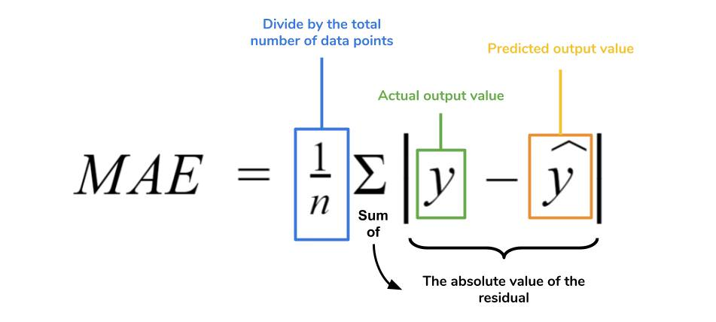
Mean Absolute Error

Slide 61
Mean Absolute Error
- Used when the distribution is Gaussian but the distribution has outliers.
- More robust to outliers.
- ‘mean_absolute_error’.

Slide 62
Losses for Binary Classification
- Binary Cross-Entropy Loss
- Hinge Loss
- Squared Hinge Loss

Slide 63
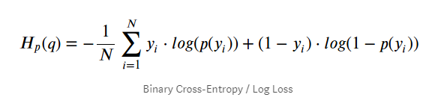
Binary Cross-Entropy Loss

Slide 64
Binary Cross-Entropy Loss
- Measure of the difference between two probability distributions for a given random variable or a set of events.
- Intended to use for binary classifications only.
- ‘binary_crossentropy’.

Slide 65
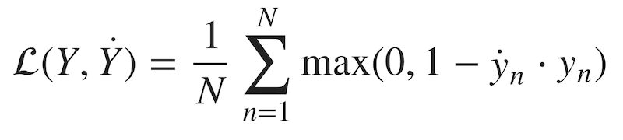
Hinge Loss

Slide 66
Hinge Loss
- Alternative to Binary Cross-Entropy.
- Was primarily developed for SVM’s.
- Encourages samples to have correct signs, assigns more error when there is a difference in signs between the actual and predicted class values.
- Hinge Loss would sometimes out-perform Binary Cross Entropy but not always.
- Needs the activation function to be the ‘tanh’ i.e ‘Hyperbolic tangent’ function
- ‘hinge’

Slide 67
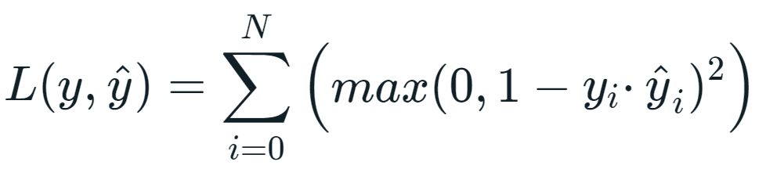
Squared Hinge Loss

Slide 68
Squared Hinge Loss
- Square of the Hinge Loss Score.
- Smoothens the surface of the error function.
- Mathematically easier to work with.
- Needs the activation function to be the ‘tanh’ i.e ‘Hyperbolic tangent’ function
- ‘squared_hinge’.

Slide 69
Losses for Multi-Class Classification
- Multi-Class Cross-Entropy Loss
- Sparse Multi-Class Cross-Entropy Loss
- Kullback Leibler Divergence Loss

Slide 70
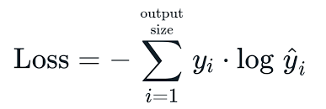
Multi-Class Cross-Entropy Loss

Slide 71
Multi-Class Cross-Entropy Loss
- To be used with cases with more than 2 classes.
- Calculates a score that summarizes the average difference between the actual and predicted probability distributions for all the classes in the problem.
- Requires the output variable to be ‘One-Hot Encoded’.
- Needs the activation function to be the ‘softmax’ function.
- The final output layer must have n-nodes/neurons one for each class.
- ‘categorical_crossentropy’.

Slide 72
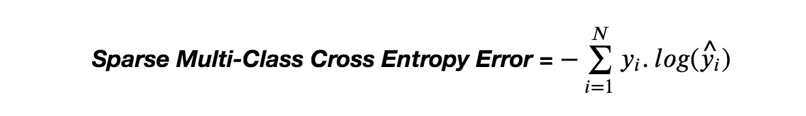
Sparse Multi-Class Cross-Entropy Loss

Slide 73
Sparse Multi-Class Cross-Entropy Loss
- One-Hot Encoding is a major problem when working with cross-entropy with a large number or labels.
- Sparse Multi-class Cross-Entropy address this issue by performing the same calculations without requiring the target variable to be One-Hot-Encoded.
- Needs the activation function to be the ‘softmax’ function.
The final output layer must have n-nodes/neurons one for each class.
- ‘sparse_categorical_crossentropy’.

Slide 74
Kullback Leibler Divergence Loss
- Measure of how a given probability distribution would differ from a baseline distribution.
- Loss of ‘0’ shows identical distribution.
- Behaves the same as cross-entropy for simple problems.
- More commonly used and is much more reliable for complex functions.
- Requires the output variable to be ‘One-Hot Encoded’.
- Needs the activation function to be the ‘softmax’ function.
- The final output layer must have n-nodes/neurons one for each class.
- ‘kullback_leibler_divergence’.

Slide 75
Section IV
Important terminologies : Neural Networks

Slide 76
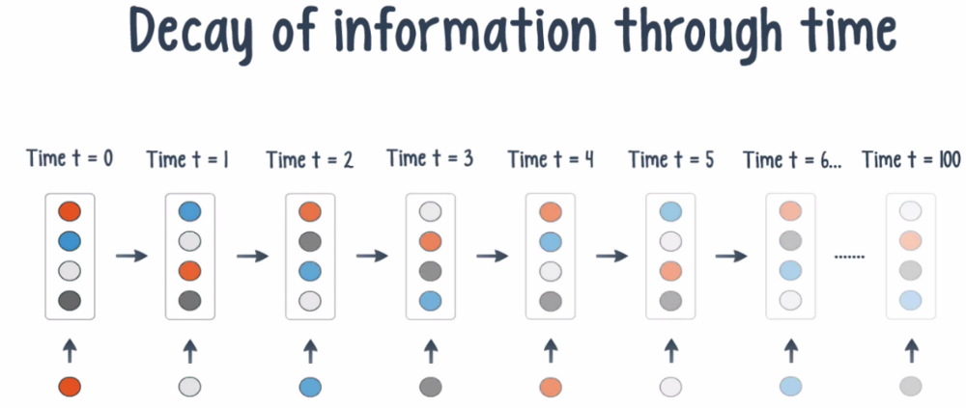
Vanishing Gradient

Slide 77
Vanishing Gradient
- Usually associated with the activation function.
- Previously, researchers had only the sigmoid function to work with.
- Sigmoid function does not allows the usage of multi layer neural networks.
- The derivative of sigmoid function lies between (0-0.25).
- When calculating the gradients for deeper Neural Networks, the gradients tend to get contracted to such a point that it would render in minimal/ negligible difference in the older and the updated parameters; This phenomenon is termed as The Problem of Vanishing Gradient.
- It leads to increased times for convergence; might also prevent the convergence to happen.

Slide 78
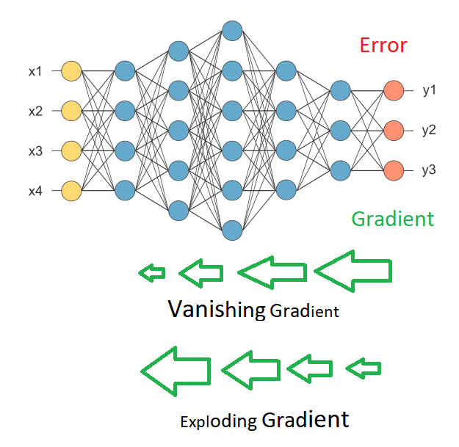
Exploding Gradient

Slide 79
Exploding Gradient
- Usually occurs because of weights.
- Because of huge weights been initialized, sometimes the magnitudes of the product of the (learning rate and the gradients) tend to cross the original parameter value which leads to the new updated weights to have negative weights i.e too much difference between the new and the old weights.
- This would make the graph to keep jumping on the Gradient descent curve and the global minima would never be found preventing the convergence to happen.

Slide 80
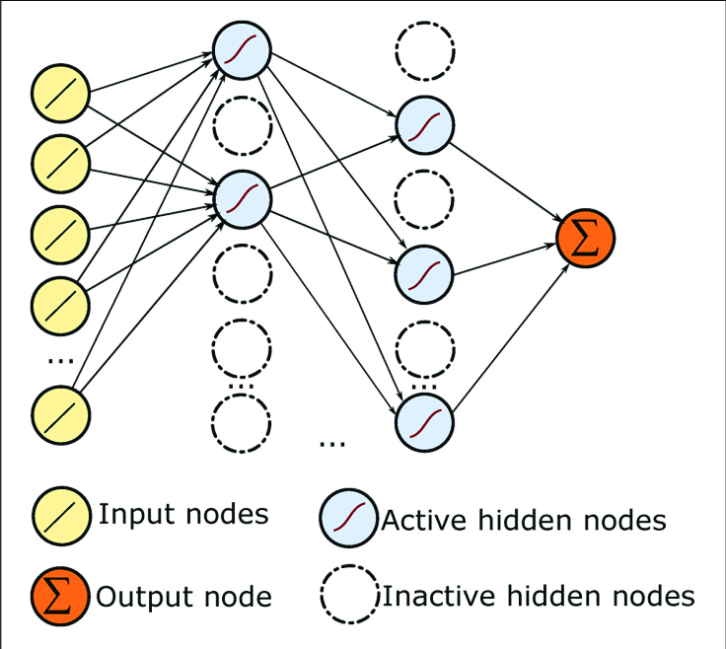
Drop-Out

Slide 81
Drop-Out
- Multilayer Neural Networks tend to overfit the data as there are many weights and biases to be tweaked.
- Just like Random Forest, where we train full depth Decision Trees on randomly selected bootstrapped features, aggregation of which results into a fine tuned and strong model.
- We can apply drop out layers between different layers that would randomly activate and deactivate the neurons of the previous layers.
- The number of neurons to be de-activated is calculated using the drop-out ratio been provided by the end user.
- These neurons are selected randomly at the start of the epoch and would change at each epoch.
- The weights of the neurons been activated would only be updated during the back propagation.
- Post training, the updated weights between these layers can simply be multiplied with the dropout ratio to get the final weights of these layers, to remove the Drop-Out layers.

Slide 82
Deep Learning
Neural Networks
Loss Functions
Activation Functions
Optimization Functions

Slide 83
Weights Initialization
- Weights should be small.
- Weights should not be the same.
- Weights should have a good variance value.

Slide 84
Uniform Distribution - Sigmoid Function
- Weights are taken from a uniform distribution.

Slide 85
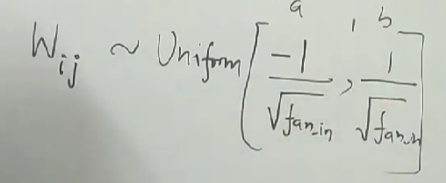
Uniform Distribution

Slide 86
Xavier/ Gorat Distribution – Sigmoid Function
1. Xavier Normal
2. Xavier Uniform

Slide 87
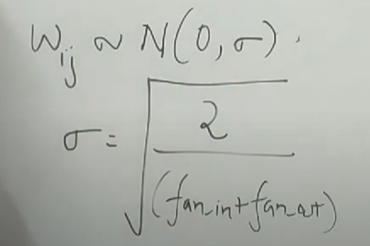
Xavier Normal

Slide 88
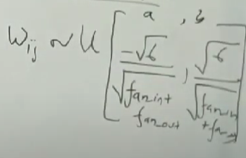
Xavier Uniform

Slide 89
He init - RELU
He Uniform
He Normal

Slide 90
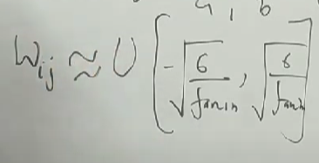
He Uniform

Slide 91
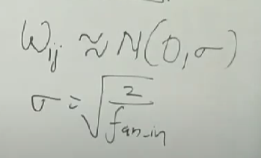
He Normal

Slide 92
Section IV
Convolutional Neural Networks

Slide 93
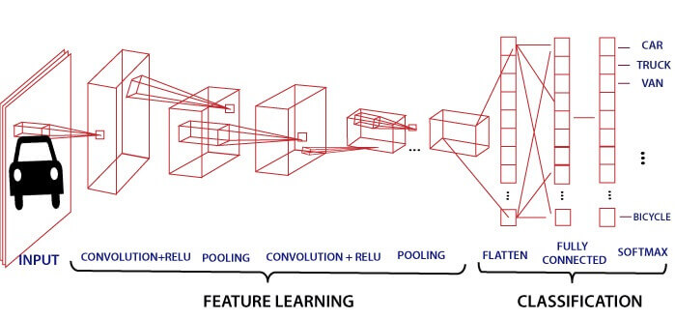
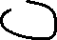
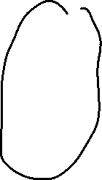
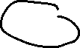
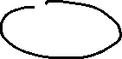


Convolutional Neural Networks

Slide 94
Data Augmentation
- Each image is a different set of numbers for a computer to learn on.
- Convolutions would help finding out distinct features from the image.
- But these features again would be nothing more than a matrix of some numbers only.
- In case a new image is fed to the NN, where there is some difference in orientation/ size/etc, the NN would fail to identify these features and would thus fail to identify the image.
- To avoid such instances, the image is processed and some ‘n’ number of versions are generated from a single image taking into consideration all the possible aspects.
- Operations like rotation, zooming, resizing, changing centers, shifting widths and heights are some of the operations been performed.
- This operation of generating many versions of a single image by tweaking a single image is called Data Augmentation or Image Augmentation.

Slide 95









Data Augmentation

Slide 96

Data Augmentation

Slide 98
Convolutions
- The convolution is a mathematical operation used to extract features from an image.
- The convolution is defined by an image kernel.
- The image kernel is nothing more than a small matrix.
- Most of the time, a 3x3 kernel matrix is very common.

Slide 99

Convolutions : How it works ?

Slide 100

Convolutions : Mathematics

Slide 101





Convolved Image Examples

Slide 102
Strides
- After each iteration, the filter is shifted over on the input matrix.
- The number of pixels the filter would shift by on the input matrix is known as the strides.
- When the number of strides is 1, we shift the filters by 1 pixel at a time. Similarly, when the number of strides is 2, we carry the filters to 2 pixels, and so on.
- They are essential because they control the convolution of the filter on the input.
- Strides are responsible for regulating the features that could be missed while flattening the image.
- They denote the number of steps we are moving in each convolution.

Slide 103

Strides

Slide 104
Padding
- After each convolution, the original size of the image shrinks i.e. information loss. More the number of convolutions, more would the information loss be.
- Secondly, when the kernel moves over the original image, it passes through the middle layer more times than the edge layers, due to which there occurs an overlap.
- To overcome this problem, padding was introduced. It is an additional layer that can add to the borders of an image while preserving the size of the original picture.

Slide 105

Padding

Slide 106
Padding
If an (n x n) matrix is convolved with an (f x f) matrix with a padding of (p), then the size of the output image will be:
(n+2p-f+1) x (n+2p-f+1)

Slide 107
Pooling
- The image size shrinks by reducing the number of parameters if the image is too large. When the picture is shrunk, the pixel density is also reduced & the downscaled image is obtained from the previous layers.
- Basically, its function is to progressively reduce the spatial size of the image to reduce the network complexity and computational cost.
- Spatial pooling is also known as down-sampling or sub-sampling that reduces the dimensionality of each map but retains the essential features.
- A rectified linear activation function, or ReLU, is applied to each value in the feature map. Relu is a simple and effective nonlinearity that does not change the values in the feature map but is present because later subsequent pooling layers are added. Pooling is added after the nonlinearity is applied to the feature maps i.e. post Convolutional layers.

Slide 108
Pooling
There are three types of spatial pooling techniques:
Max Pooling
Average Pooling
Sum Pooling

Slide 109
Max pooling
- Max pooling is a rule to take the maximum of a region and help to proceed with the most crucial features from the image.
- It is a sample-based process that transfers continuous functions into discrete counterparts.
- Its primary objective is to downscale an input by reducing its dimensionality and making assumptions about features contained in the sub-region that were rejected.

Slide 110



























Max pooling

Slide 111
Average Pooling
- It is different from Max Pooling as it retains information about the lesser essential features.
- It simply downscales by dividing the input matrix into rectangular regions and calculating the average values of each area.

Slide 112












Average Pooling

Slide 113


Sum Pooling
- It is similar to Max pooling, but instead of calculating the maximum value, we calculate the sum of each sub-region.

Slide 114





Sum Pooling

Slide 115












CNN Working

Slide 116
Additionals
What are dropouts?
A dropout is an approach where randomly selected neurons are ignored during training; they are dropped out randomly. In other words, their contribution to the activation of downstream neurons is temporarily removed on the forward pass, and any weight updates are not applied to the neuron on the backward pass.

Slide 117
How is convolution different from pooling?
The significant difference is that a convolution layer extracts features from the data matrix, whereas the pooling layer only downsamples the data matrix.

Slide 118
How many filters must a CNN have?
CNN does not learn with a single filter; they know through multiple features in parallel for a given input. For example, it is usual for a convolution layer to learn from 32 to 512 filters in parallel for a piece of shared information.

Slide 119
Thank You

